Slide 1
Smart Lock Screen for Android
Aravind Sagar
V Priyan
Dr. Gourinath Banda (Guide)
Notes:
Good morning
Self Introductions
Our project is Smart Lock Screen for Android

Slide 2

/aravindsagar/SmartLockScreen

Slide 3
The Problem
Notes:
Smartphones – popular
Lot of personal data
Adding high portability creates privacy issues

Slide 4
< $500
$500
Pin
None
$1000
Money people ready to spend to retrieve data^{[3]}
Security Status of the phone^{[4]}
Smartphone Security Statistics
Notes:
Shows that phones contain important data
But people not ready to put high security in phones. Why?
Theft is not the only scenario. Many privacy compromising scenarios like sharing phone with others etc

Slide 5
195
mins
Once every 6 secs
98
mins
110
times / day
2013
evenings
2011
average
Time spent^{[1]}
Checking the phone^{[2]}
Smartphone Usage Statistics
Notes:
The amount of interaction with phones – high security makes it cumbersome and inconvenient

Slide 6
Sharing
Convenience
Security
VS
The Trade Off
Notes:
Clearly there is a trade-off

Slide 7
Making the smartphone accessible as quick as possible without compromising security.

Slide 8

Sharing
Convenience
Security
Solution – Creating a perfect balance

Slide 9
The Idea
Environment based authentication
Glance-able notifications
Multiple User Profiles
1
2
3
Notes:
Three main components

Slide 10
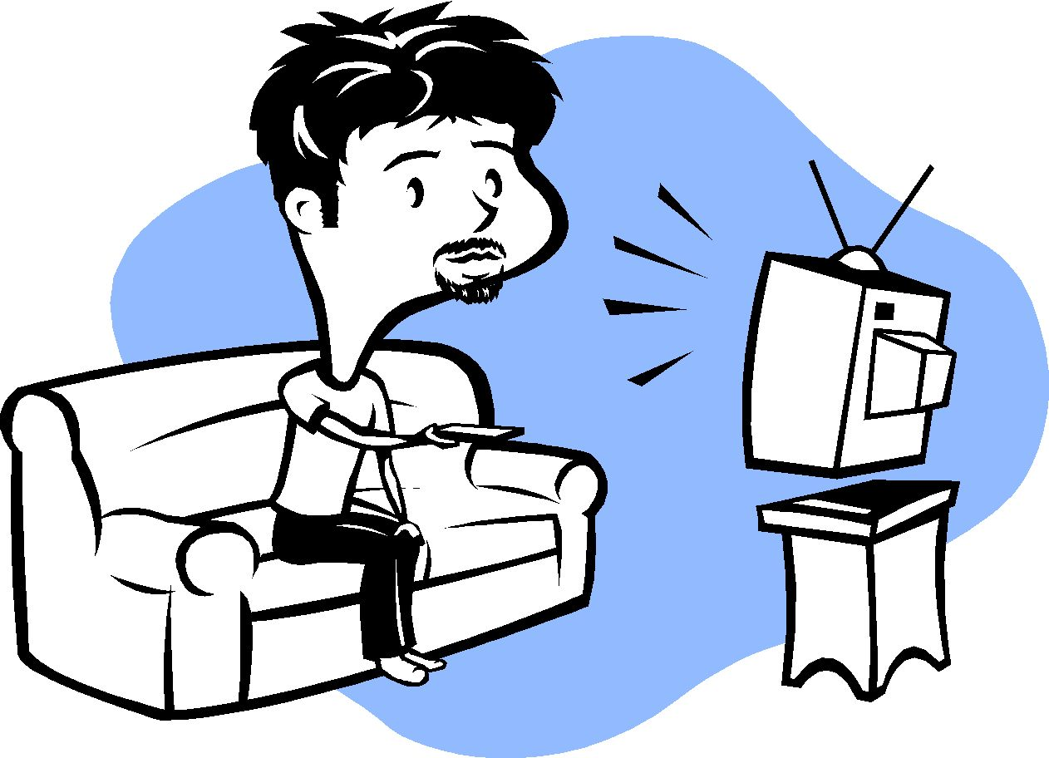

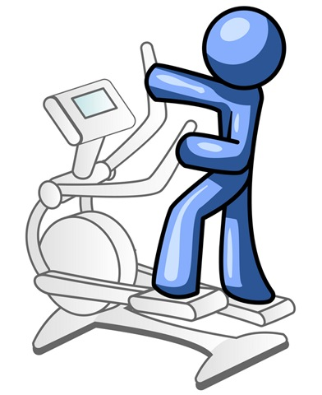
1
User
Environment
Security Level : High
Security Level : Low
Security Level : Medium
Notes:
User not present in a single context.
Security preferences vary.
Make the phone context-aware.
Provide a mechanism for the user to make the phone understand his contexts and corresponding security preferences.
The phone automatically detects the context changes continuously.

Slide 11
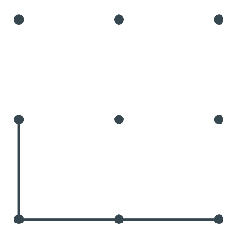
1
Varying
Security
Security Level : High
Security Level : Low
********A
Direct Unlock
Alpha-Numeric Password
Pattern
Security Level : Medium
Notes:
Vary the security level of the phone depending on the context as defined by the user.

Slide 12



1
Determining the User Context / Environment
Notes:
How do we define an environment?

Slide 13

1
Fused Location:
GPS
Wi-Fi
Cellular Network
Determining the User Context / Environment
Notes:
Fused location:
- Fast
- Saves battery

Slide 14



1
G
Password
Wi-Fi
7
Pin
Environment
Password
Bluetooth
Pattern
Location
None
The user defines the environment by selecting variables
Then, allots a password for the environment
Environment Creation

Slide 15
1
Background Process
Get Various Sensor Data
Detect Context Based on sensor data
Change passphrase based on context
Phone Unlocked
User enters correct Passphrase
Lock Screen
Foreground Process
App flow

Slide 16
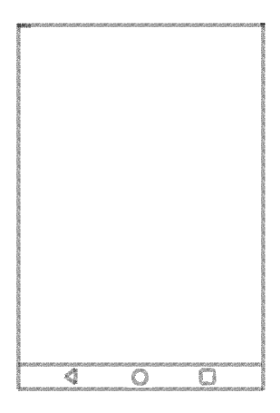
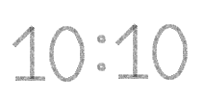

2
Getting app notifications directly in the lock screen
Glance-able notifications right from the lock screen

Slide 17
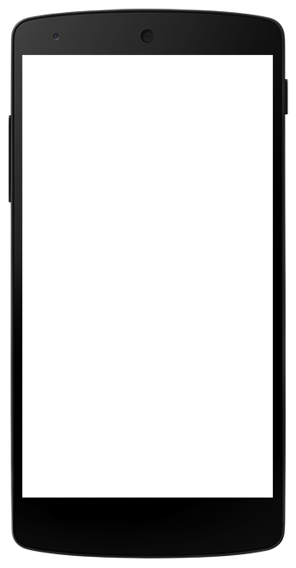































3

Slide 18
Design & Implementation
Back-end
User Interface

Slide 19

Android
Powerful SDK
Wide popularity
Open source
Platform

Slide 20

SQLite database, with Content Provider
Broadcast listeners for sensor value changes
Central module – background ‘Service’
Admin module for background password
Notification Service
App lock service
Back-end

Slide 21
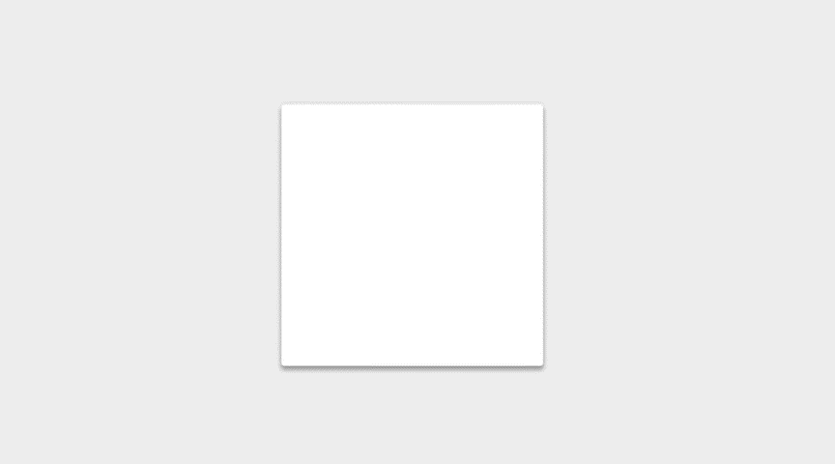
The User Interface follows Google’s Material Design specifications
with smooth animations
and vibrant colors
UI Design Principles

Slide 22
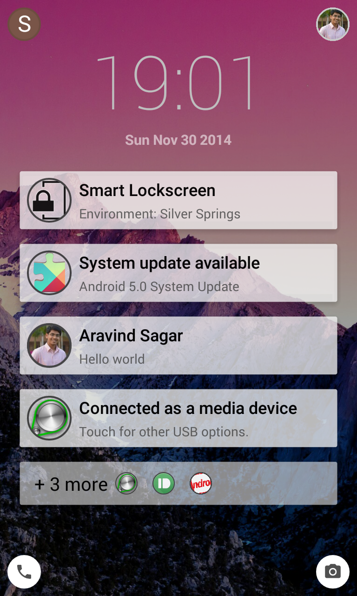
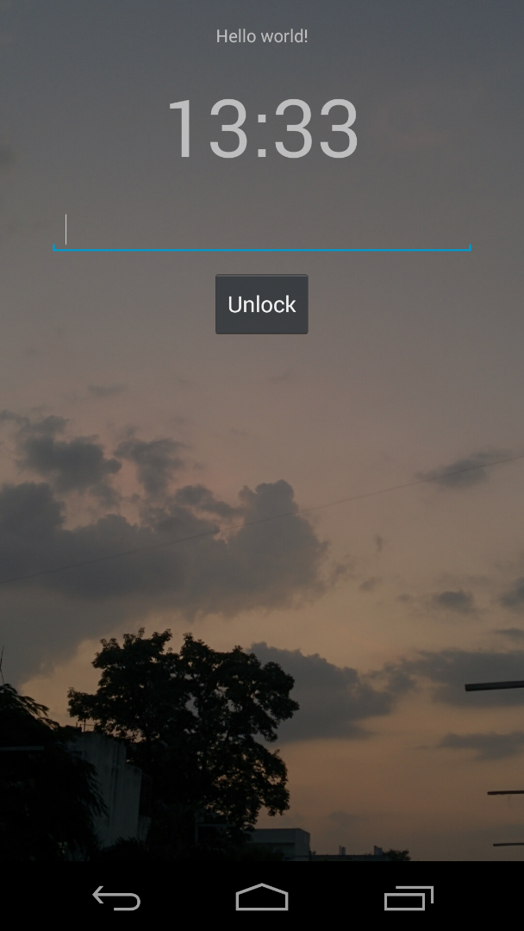
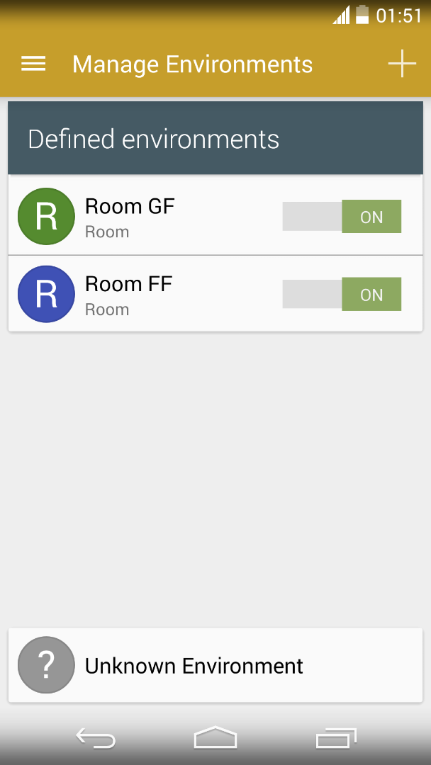
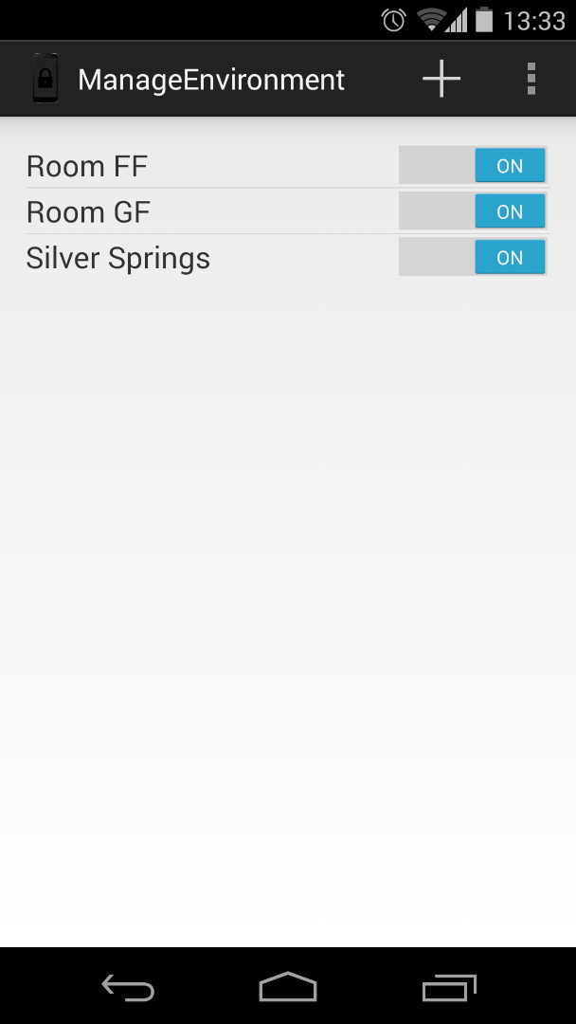
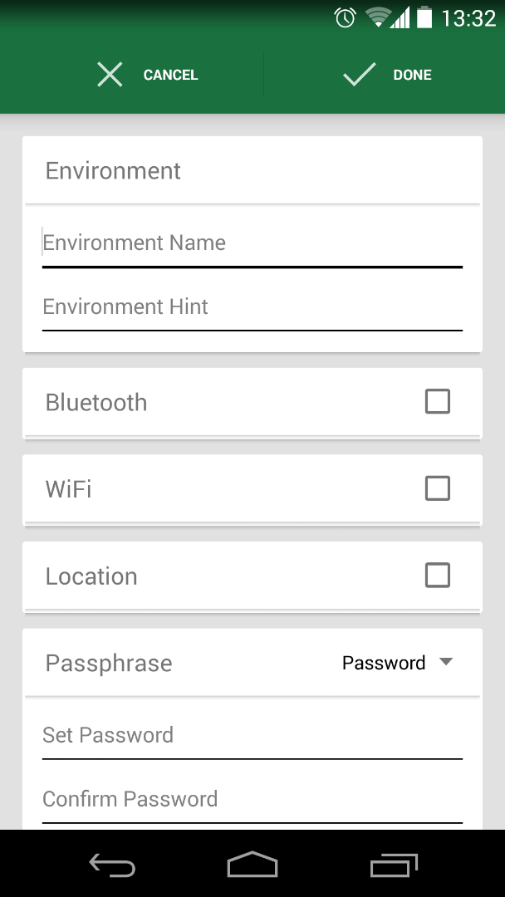
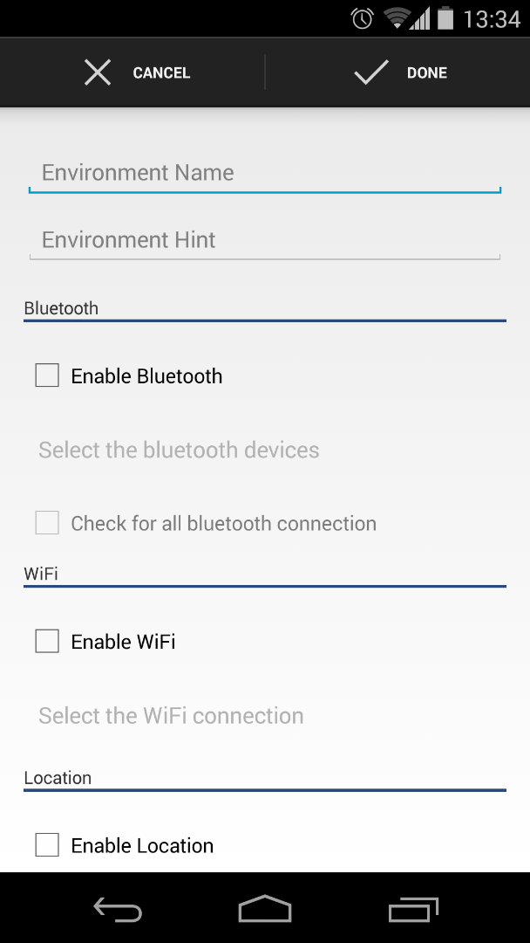
UI

Slide 23




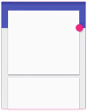

Inception
Environment Detection
Lock-screen Overlay
Notification Access
31 Aug
11 Sept
4 Oct
!
20 Nov
5 Aug
6 Sept
15 Sept
26 Oct
DB Back End
Basic UI
UI Material redesign
User Profiles
Original BTP plan
Progress Timeline

Slide 24
Demo

Slide 25
In Action

Slide 26
Scenario I
An Employee in a company
Office (30%) – Easy Pattern
Home (50%) – No Password
Others (20%) – Difficult Password
Without our app: 594 Seconds (Using difficult password always)
With our app: 280 seconds
Assuming 110 unlocks per day [2]
Possibility of faster access to phone

Slide 27
Scenario II
A Student
College (25%) – No Password (User always has phone with him)
Hostel (55%) – Easy Pattern
Others (20%) – Pin
Without our app: 333 Seconds (Using difficult password always)
With our app: 250 seconds
Assuming 110 unlocks per day [2]
Possibility of faster access to phone

Slide 28

April 2014
June2014
Smart Lock Screen
Lollipop Smart Lock
Allows the user to skip password entry when connected to ‘Trusted Devices’
Limited to only Bluetooth devices
Simply skips secure lock and no password change – No scope for further customization
Google’s step

Slide 29
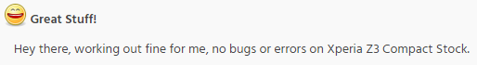
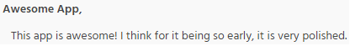
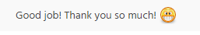
We started Alpha testing of our app in XDA Developer Forums [5]
3500+
18 days
-androidjunkie02
1000+
7 days
-aq24
Alpha - II
-rogeraugusto_
Alpha - I
No. of downloads
-Floxo
XDA alpha testing
Notes:
WonderHowTo featured the app

Slide 30
Challenges faced

Slide 31
Solved
Enabling pattern unlock
Delay-free lock screen overlay
Environment overlap resolution
To be solved
Lollipop compatibility
Notification access in Android 4.2 and lower
Challenges

Slide 32
Future Work

Slide 33
Extending environments using more sensors
A configurable framework for adding sensors by users
Tool for generating source code
Android Sensor framework in the backend [6]
Configuration Tool

Slide 34
Automatic screen on/off
Detect picking up and putting down of phone
Gravity and proximity sensors
More environment based actions
Sound profiles
Cellular network switching
Extending Sensor uses
Notes:
Environment actions are indicative, many types of actions are possible

Slide 35
References
[1] Sale, Stephen, Scott, Martin. Consumers use smartphones for 195 minutes per day, but spend only 25% of that time on communications.
http://www.analysysmason.com/About-Us/News/Insight/consumers-smartphone-usage-May2014-RDMV0/ (12 Nov 14)
[2] Woollaston, Victoria. How often do you check your phone? The average person does it 110 times a DAY (and up to every 6 seconds in the evening).
http://www.dailymail.co.uk/sciencetech/article-2449632/How-check-phone-The-average-person-does-110-times-DAY-6-seconds-evening.html (12 Nov 14)
[3] Eadicicco, Lisa. People Are Willing To Go To Extreme Lengths To Retrieve Their Stolen Smartphones
http://www.businessinsider.in/People-Are-Willing-To-Go-To-Extreme-Lengths-To-Retrieve-Their-Stolen-Smartphones/articleshow/34790154.cms (12 Nov 14)

Slide 36
References
[4] Tapellini, Donna. Smart phone thefts rose to 3.1 million last year, Consumer Reports finds Industry solution falls short, while legislative efforts to curb theft continue.
http://www.consumerreports.org/cro/news/2014/04/smart-phone-thefts-rose-to-3-1-million-last-year/index.htm (12 Nov 14)
[5] Sagar, Aravind. [APP][ALPHA v1.4][Nov23] SmartLockScreen for Android - Now with restricted profiles.
http://forum.xda-developers.com/android/apps-games/app-smartlockscreen-android-enjoy-t2919989 (29 Nov 14)
[6] Android Developers. Sensors Overview.
http://developer.android.com/guide/topics/sensors/sensors_overview.html
(28 Nov 14)

Slide 37
Thank you

